Slide 1

MAJOR PROJECT PRESENTATION
VAAGDEVI ENGINEERING COLLEGE
TEAM - A009
PROJECT NAME:
TIME SERIES ANALYSIS FOR CAR SALES FORECASTING USING PROPHET

Slide 2

Group Members :
N . Durga Bhavani
(18UK1A0541)
G .Manasa
(18UK1A0515)
B .Veerendrachary
(18UK1A0565)
K . Kavya (18UK1A0524)
Guided By – B.Ambika
(Assistant Professor)

Slide 3

TIME SERIES ANALYSIS FOR CAR SALES

Slide 4
TABLE OF CONTENTS :
ABSTRACT
PURPOSE
TECHNICAL ARCHITECTURE
PROPOSED WORK AND METHODOLOGY
ADVANTAGES
DISADVANTAGES
CONCLISION
FUTURE SCOPE

Slide 5
ABSTRACT
Below is the Brief of our Project:
Forecasting or predicting the sales value helps the investors to invest in such a time where profits can be maximum.
This project provides guidance to individuals who are willing to invest or buy a car and help them in knowing the price of a day.
By using the prophet library the investor will knowing the sales of a car.
It is built on the monthly sales data from 1960 – 1968.
Time series analysis is made on the data for accurate predictions.

Slide 6
Here Prophet is an additive regression model with a piecewise linear or logistic growth curve trend
It includes a yearly seasonal component modeled using fourier series and a weekly seasonal component modeled using dummy variables.
Time series methods makes forecasts based solely on historical patterns in the data.
Time series forecasting is a technique for the prediction of events through a sequence of time.
Prophet automatically detects changes in trends by selecting change points from the data.

Slide 7
Purpose
Time series analysis helps organizations as well as individuals understand the underlying causes of trends or systemic patterns over time.
Time series analysis is a specific way of analyzing a sequence of data points collected over an interval of time.
Time is a crucial variable because it shows how the data adjusts over the course of the data points as well as the final results.
Additionally, time series data can be used for forecasting.
Used for forecasting – predicting future data based on historical data.

Slide 8
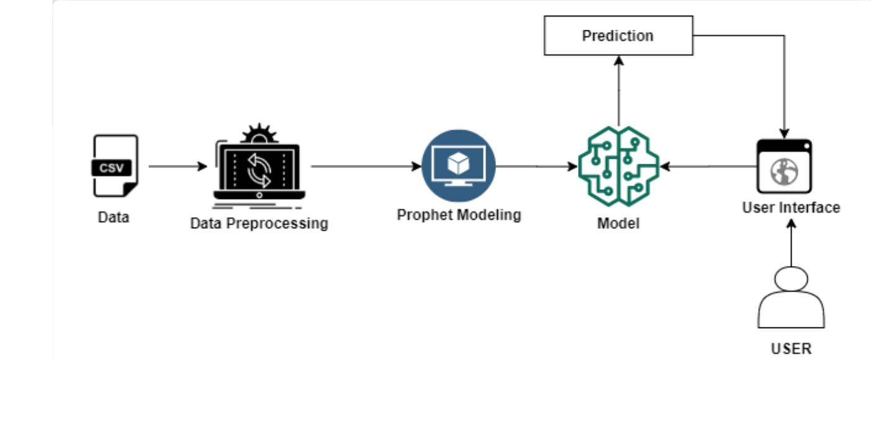
TECHNICAL ARCHITECTURE

Slide 9
Proposed work and methodology
● fbprophet : FbProphet is a powerful time-series analysis package released by Core Data Science Team at Facebook.
● It is a simple and easy to go package for performing time-series analytics and forecasting at scale.
● prophet : Prophet is robust to missing data and shifts in the trend, and typically handles outliers well.
● Flask : Web framework used for building Web applications.
● Prophet Library : prophet library is an open-source library designed for making forecasts for univariate time series datasets.

Slide 10
Advantages
● Time series analysis and forecasting is a collection of observations in chronological order.
● These could be daily stock closing prices, weekly inventory figures, annual sales, or countless other things.
● Finally, a time series forecast is taking those parts observations and making predictions about what will happen in the future if the same patterns continue to hold true.
● Prefect for creating complex patterns from the input time series dataset.
● It has the special feature that it would remember every each information.

Slide 11
DIS-Advantages
● The big challenge is during the training period.
● Expensive computation cost.
● Short range forecasts are less accurate than long range forecast is not true for forecasting.

Slide 12
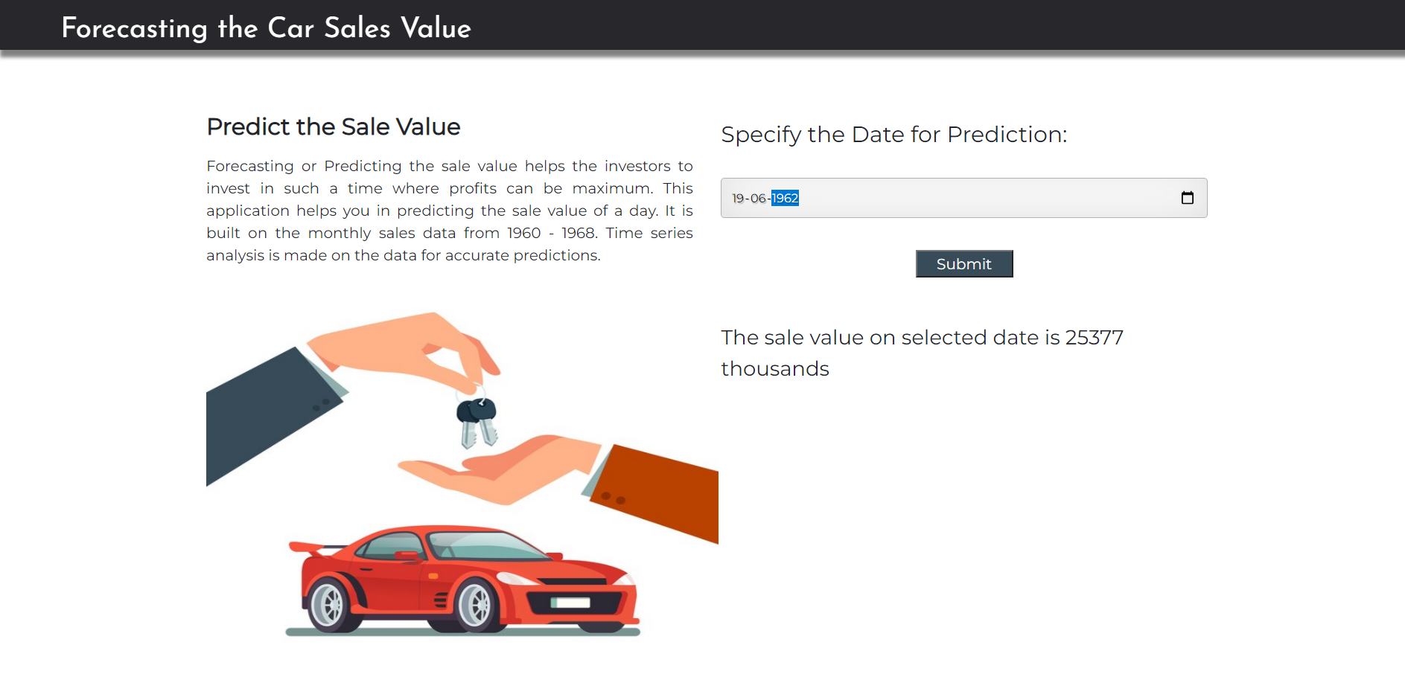
Conclusion
● Forecasting the car sales values and predict the sales values.
● predicting the sale value helps the investors to invest in such a time where profits can be maximum.
● Time series analysis is made on the data for accurate predictions.

Slide 13
FUTURE SCOPE
Time series forecasting is the use of a model to forecast future events based on known past events to predict data points before they are measured predicting the sale value helps the investors to invest in such a time where profits can be maximum.
The Scope of time series is huge and so is the field of time series analysis.

Slide 14

THANK YOU

